Slide 1
PennAthletics
Mid-Point Check-in
Mar 24, 2023

Slide 2
Agenda
Team Introduction
Timeline Review
Framework Overview
Approach
Preliminary Output
Next Steps

Slide 3





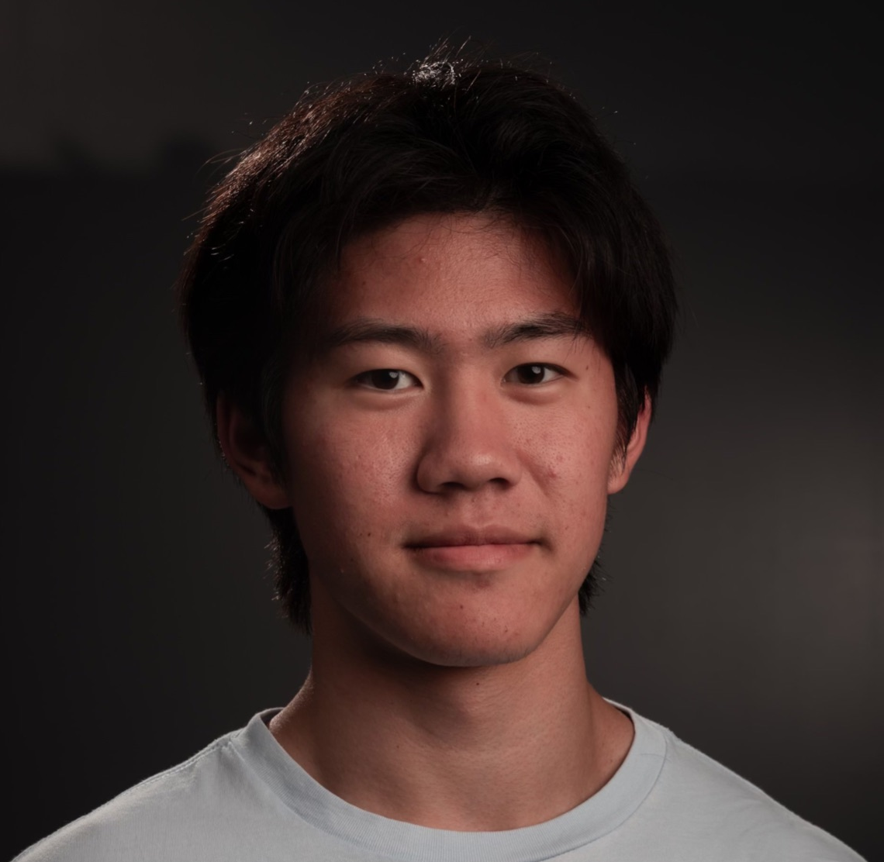

Team Introduction
Matthew Thwaites
Engagement Lead
MBA’25
Yue Chen
Technical Lead
ENG’23, DS
Jason Wang
Senior Analyst
CAS’24 Biophysics
Andrew Yang
Senior Analyst
CAS’25, Psychology
Your photo here
Aeshon Balasubramanian
Junior Analyst
ENG’26, CIS
Kai Wang
Junior Analyst
ENG’26 Systems Engineering
Andrew Mao
Junior Analyst
WH’26 ENG’26 M&T

Slide 4
Research Framework
Task 1: Predict coach perception of endurance/strength/speed from physical measure
Phase I
Task 2: Find signal from in-game data
Task 3: Find signal in a subset of the GPS data (during critical game events)
Phase II
Task 4: Bottom up from test results, cluster analysis to determine ~Speed, Endurance, Strength

Slide 5
Major Project Timeline: Breakdown
Phase 1: Training & Coach Assessment Data Analysis
5 weeks
Phase 2: GPS & Game Data Analysis
5 weeks
Week 0-2
Data Preprocessing & Exploration
Week 3
Correlation Analysis
Week 5
Preliminary Results
Week 6-7
GPS & Goals Analysis
Week 8
Analysis Finalization
Week 9-10
Final Presentation & Wrap-up
Received GPS & training data at week 2
Clean and join GPS with training data
Extract useful features from GPS data
Received coach assessment & player stats data
Find correlations between training, coach assessment, and player performance
Find factors in players training contributing to coach’s assessment
Visualize important GPS features
Receive data player and timestamp of goal shot
Analyze the player’s behavior before a goal is scored
Combine results from GPS analysis and training analysis
Convert results into actionable items for PennAthletics and coaches
Present final results
Hand over analysis framework and files to PennAthletics
Notes:
Flora

Slide 6
Project Overview
Objective: use Penn Athletics data to better inform coaches on training and game strategy
Physical Training
Flying 10, Beep Test, 5-10-5,etc.
Coach Assessment
Speed, Endurance, Strength, etc.
Player Stats
Goals, Minutes Played, etc
Player GPS data
Coordinates, speed, etc.
What factors are coach assessments based on?
Does player performance reflect coach assessment?
What are player’s behaviors before goals?
Recommendations to coaches on assessing and training players
Recommendations to coaches on choosing player’s positions based on their abilities
Notes:
Flora

Slide 7
Approach: Training & Coach Assessment Data Analysis
Correlation analysis
High correlation between training performance and coach assessment indicates that coach assessments accurately reflect player’s ability shown in training
High correlation between player performance and coach assessment indicates that coach assessments accurately reflect player’s ability shown in games
Linear regression
e.g. Coach_{Speed} = f(test _{beep-test}, test₃₀₋₁₅ , test_{fly10} , test_{fly5-0-5}, …, test_{x})
Coefficient of each test corresponds to the contribution of each test in coach assessment
Physical Training
Flying 10, Beep Test, 5-10-5,etc.
Coach Assessment
Speed, Endurance, Strength, etc.
Player Stats
Goals, Minutes Played, etc

Slide 8
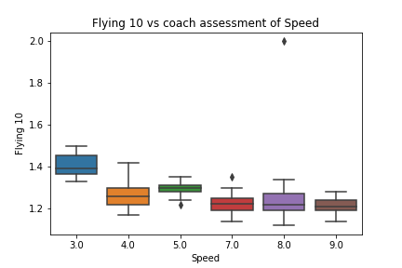
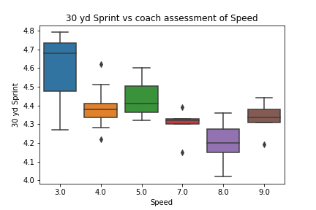
Correlation between Speed Tests and Assessment
Longer time in speed tests indicates lower speed assessment
30 yd sprint has the highest correlation
Notes:
Jason

Slide 9
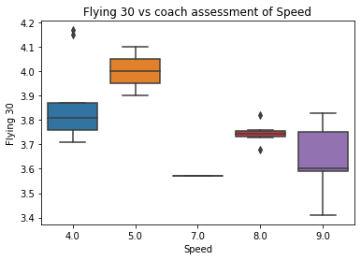
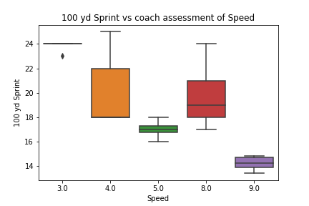
Correlation between Speed Tests and Assessment
Longer time in speed tests indicates lower speed assessment
30 yd sprint has the highest correlation
Notes:
Jason

Slide 10
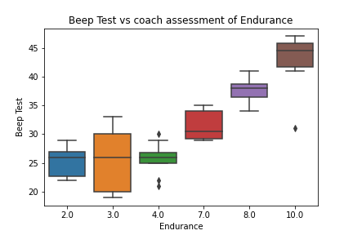
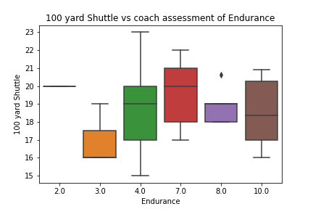
Correlation between Endurance Test and Assessment
Higher number in beep tests indicates higher endurance assessment
Longer time in shuttle tests indicates lower endurance assessment
Beep test has the highest correlation
Notes:
Jason

Slide 11
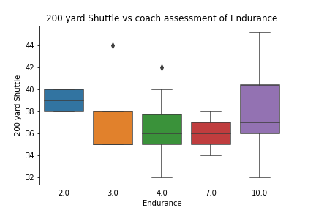
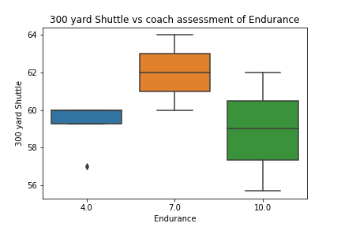
Correlation between Endurance Test and Assessment
Higher number in beep tests indicates higher endurance assessment
Longer time in shuttle tests indicates lower endurance assessment
Beep test has the highest correlation
Notes:
Jason

Slide 12
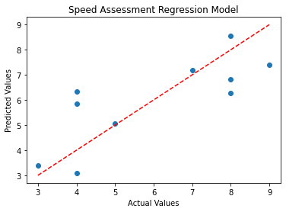
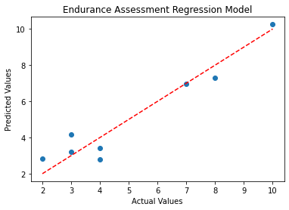
Task 1: Factors of Coach’s Assessments
Test | Coefficient
30 yd Sprint | -1.12
100 yd Sprint | -0.37
Flying 30 | -0.35
Flying 10 | -0.04
Test | Coefficient
100 yd Shuttle | -2.25
Beep Test | 1.65
200 yd Shuttle | 1.28
300 yd Shuttle | 1.27
Takeaway: coach assessments are reliable
Notes:
Kai key points:
looked at two data sets: field hockey player training data set (logged workouts of specific players) and 2021-2022 coach assessments (had scores for players on attributes like teamwork, speed, strength, etc)
(make this less technical)
wanted to see which tests (speed and endurance related) significantly influenced speed and strength assessments
processing data – ended up identifying 4 exercises to use for regression for speed and 4 for endurance (this is more intermediate endurance).
merged this dataset w coach assessment dataset – did linear regression to try to predict speed and endurance assessments.
getting kind of weird coefficient results (negatives), but possibly because tests are inherently collinear.
big takeaway is that 30 yd sprint is significant in speed assessment and beep test also significant.
Aeshon - little aside after main content of slide on that we also began exploring skills but did not bear much fruit

Slide 13
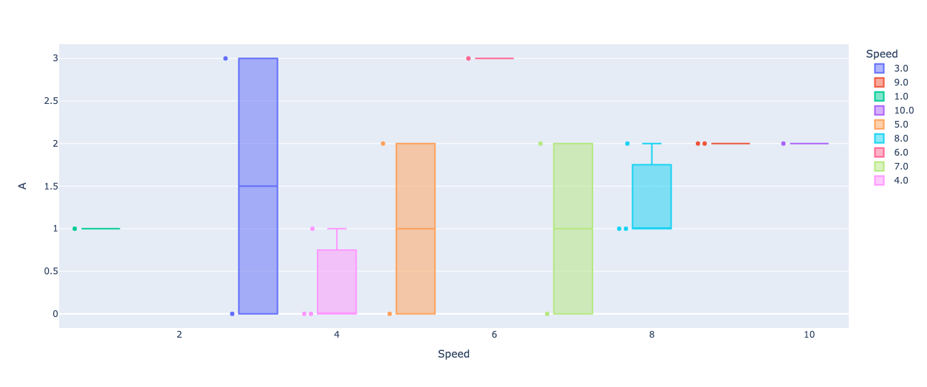
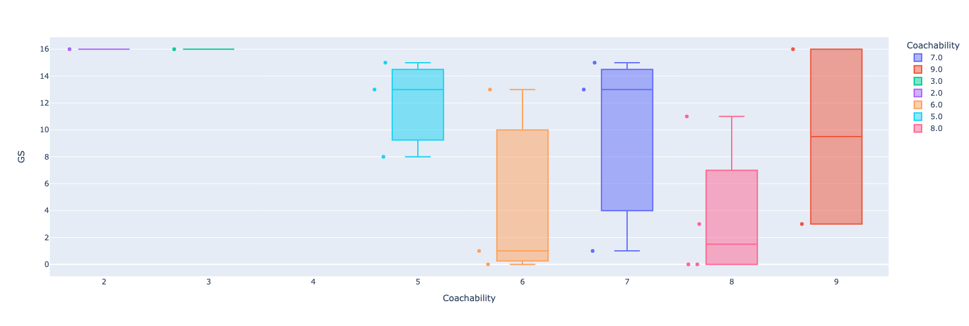
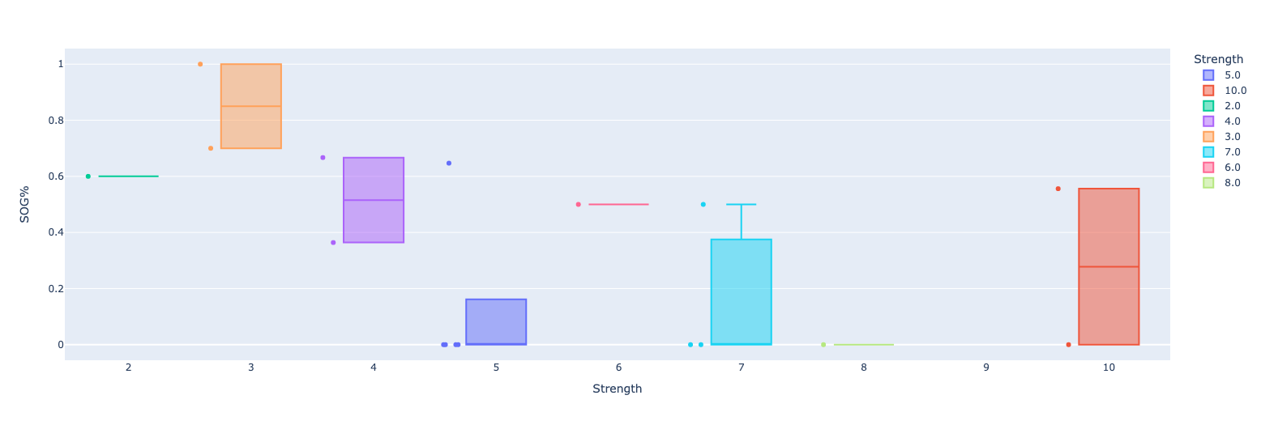
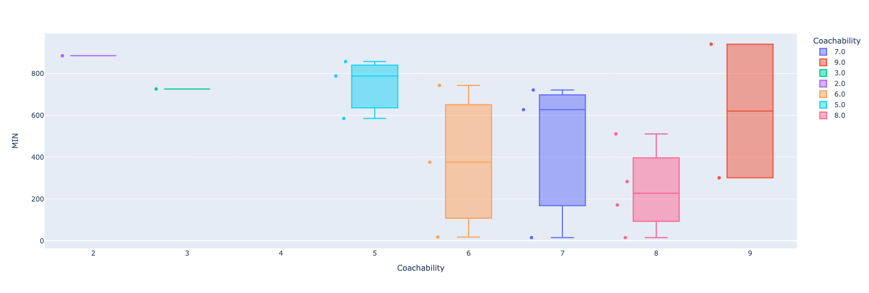
Task 2: Coach Assessment and In Game Results
Speed vs. Assists
Coachability vs. Games Started
Strength vs. Shots %
Coachability vs. Minutes Played
Low statistical significance (N=25) for observations, which limits takeaways
Shots on goal % correlated with Strength
Greater coachability leads to more minutes played (except for 2 exceptions)
Similar results between coachability & minutes played/games started
Notes:
Andrew
Exceptions for coachability: Fagan and Clarkson

Slide 14
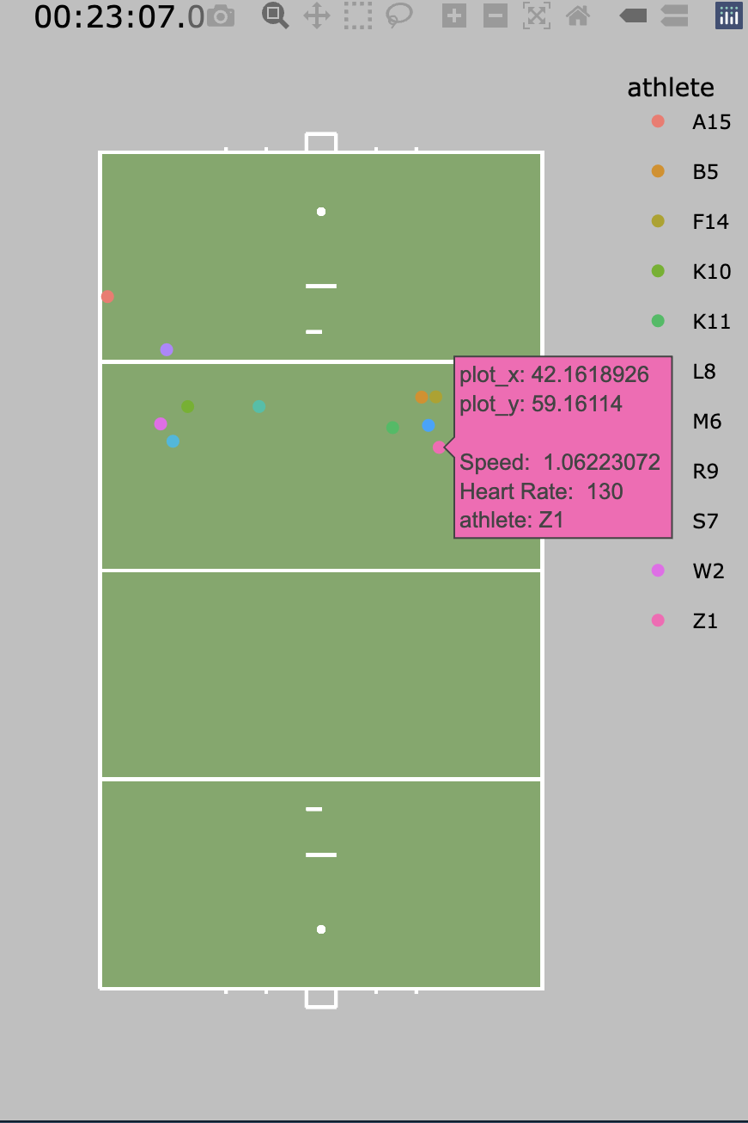
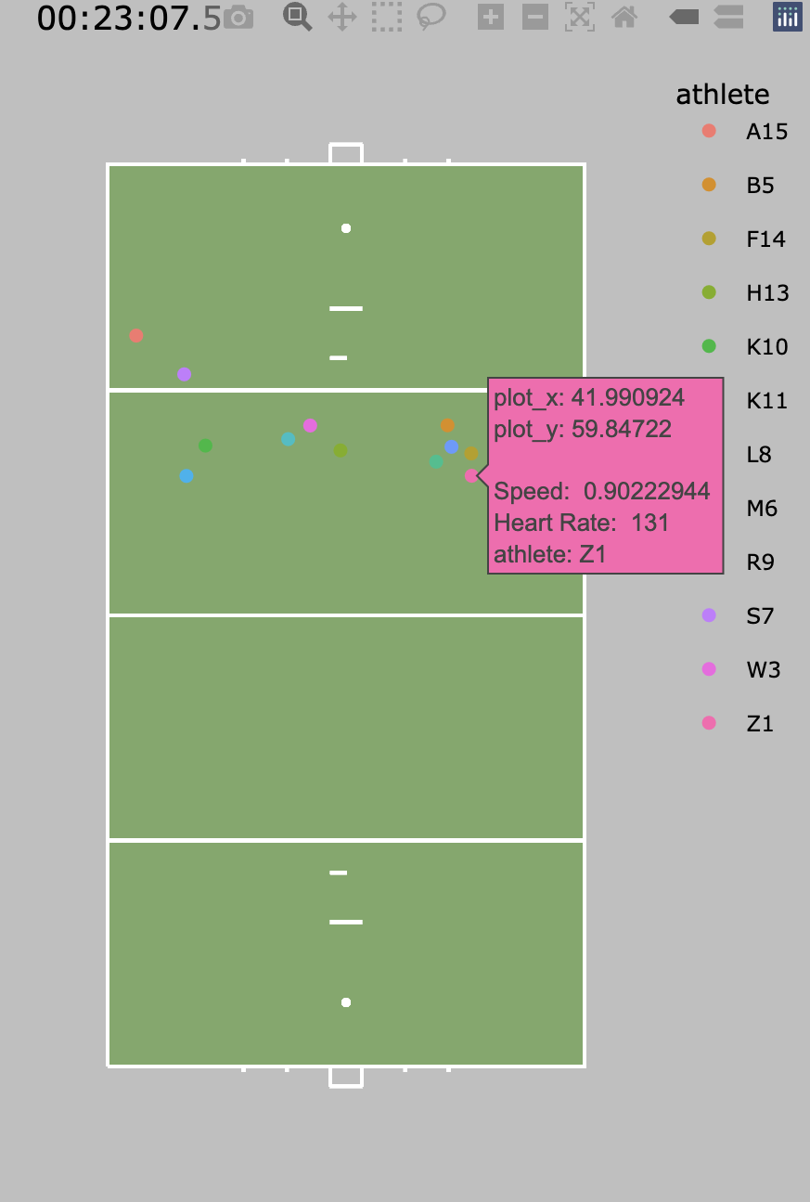


Task 2: Signal In GPS Data
Right: Player Z1 vs Brown from 23:07-23:08.5
Developed a function to isolate GPS & Player Information for given time point during home games.
Converted GPS Data to Visualization Package.
Necessary intermediate step for looking at critical events.
Notes:
Andie

Slide 15
Next Steps
Relate training & assessment data to GPS data, incorporate distribution
Identify Critical Event timestamps in the GPS data
Look for trends 30s before a shot on goal
What factors affect Goal vs. Not-Goal
Generate usable insights for the Field Hockey team’s offensive strategy

Slide 16
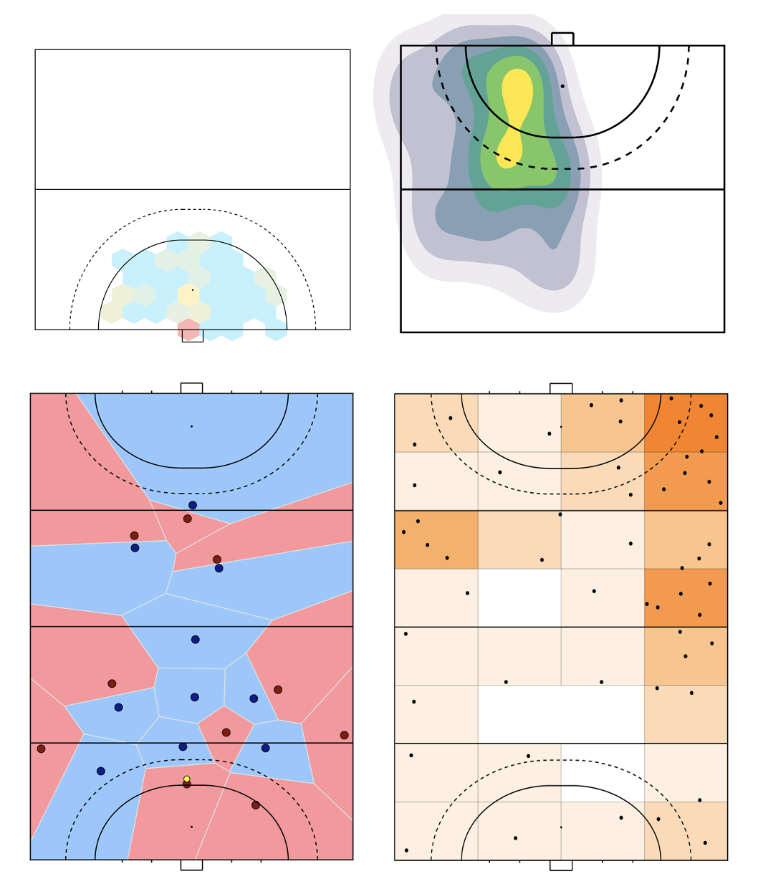
NAME OF INITIATIVE

Slide 17
Thank you!
Any Questions?

Slide 18
Approach: Training & Coach Assessment Data Analysis
What are player’s behaviors before goals?
Cluster analysis
Prediction
Player GPS data
Coordinates, speed, etc.

Slide 19
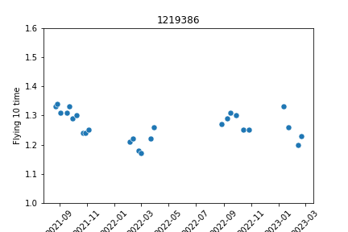
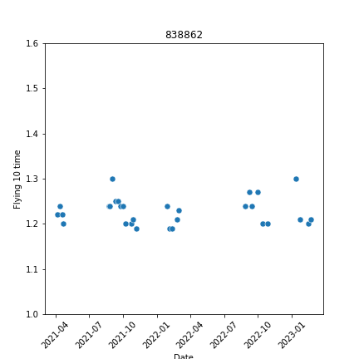
Flying 10 times for individual players over time
Best case
Most don’t improve over time
NAME OF INITIATIVE
Notes:
Jason
Not many visible improvements over time. Same goes for 100 yard shuttle. Chose these exercises because they have the most data.

Slide 20
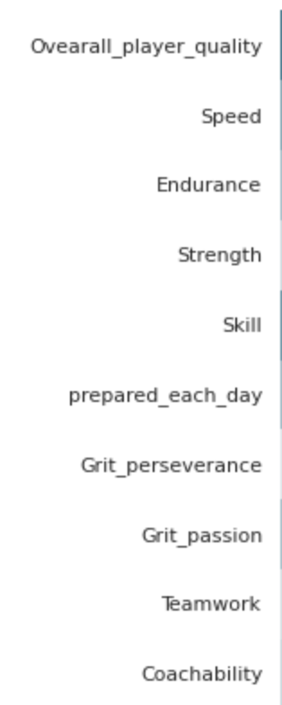
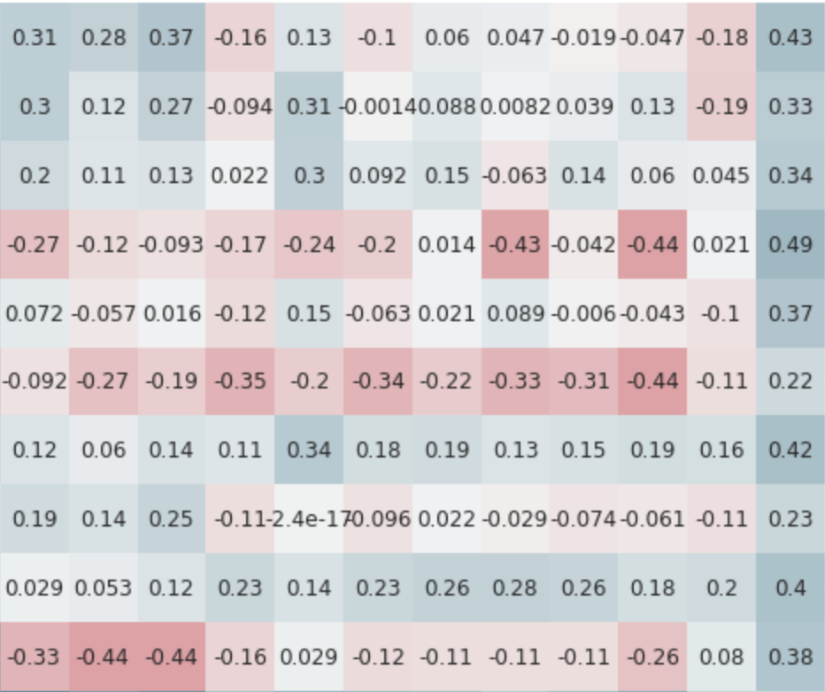

Heatmap for Coach Assessment and In Game Results

Slide 21
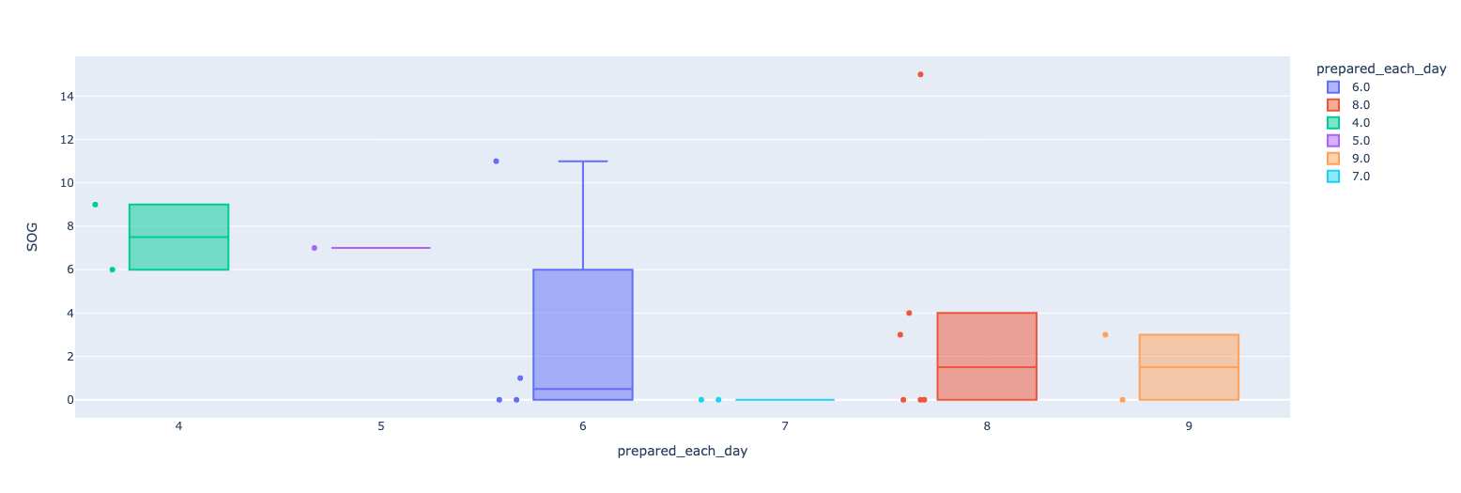
Correlation between Coach Assessment and In Game Results
Preparedness vs. Shots on Goal
NAME OF INITIATIVE
Notes:
Coach’s Bias

Slide 22
Correlation between Coach Assessment and In Game Results
Coachability vs. Games Started
NAME OF INITIATIVE
Notes:
Coach’s Bias

Slide 23
Correlation between Coach Assessment and In Game Results
Coachability vs. Minutes Played
NAME OF INITIATIVE
Notes:
Coach’s Bias

Slide 24
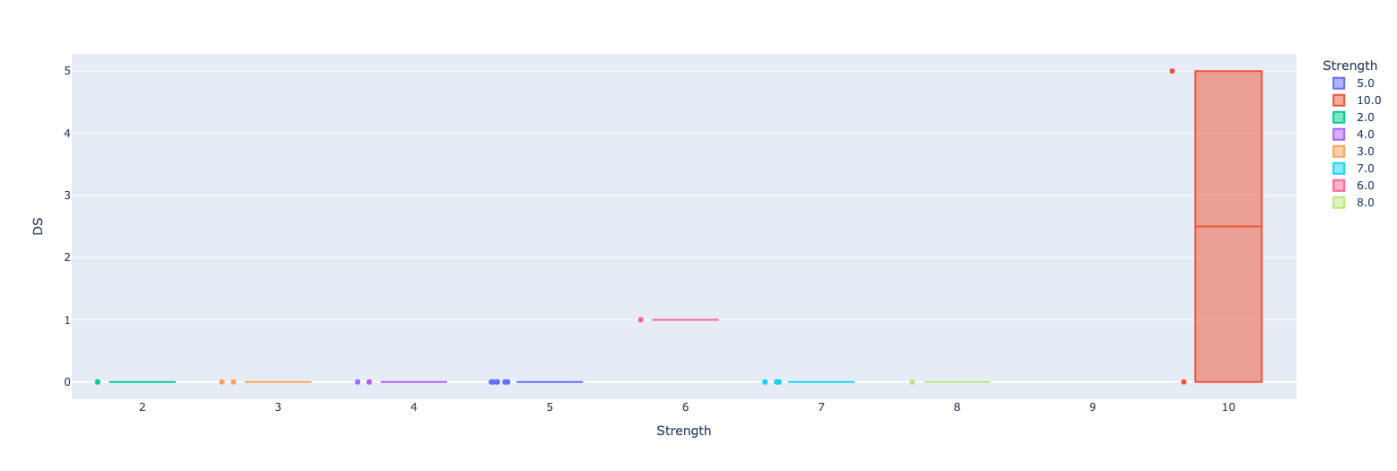
Correlation between Coach Assessment and In Game Results
Strength vs. Dangerous Shots
NAME OF INITIATIVE
Notes:
Not rlly meaningful to the data

Slide 25
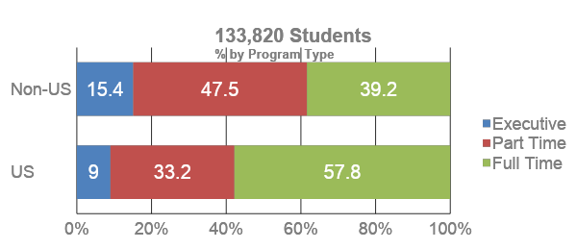
A Title Only Slide with Chart
Source: AACSB International
NAME OF INITIATIVE

Slide 26
Graphic Resources
Fonts:
Arial, bold (header and body copy)
Arial Narrow all caps (graphic titles)
Penn Blue
Penn Red
ARROW
Title text
Main body text
Highlight text
Optional body text
SIMPLE TITLE
Minimal Descriptive Text
SIMPLE TITLE
Minimal Descriptive Text
SIMPLE TITLE
Minimal Descriptive Text
SIMPLE TITLE
Minimal Descriptive Text
SIMPLE TITLE
Minimal Descriptive Text
Use these secondary colors sparingly, e.g. in charts and data representation.
NAME OF INITIATIVE

